Slide 1


Adaptive Cruise Control Arduino with C programming
ELECTRICAL ENGINEERING AND COMPUTER SCIENCE, COLLEGE OF ENGINEERING AND PHYSICAL SCIENCES
Notes:
Updated 13 Jun 2024 by Noah Mulvaney

Slide 2
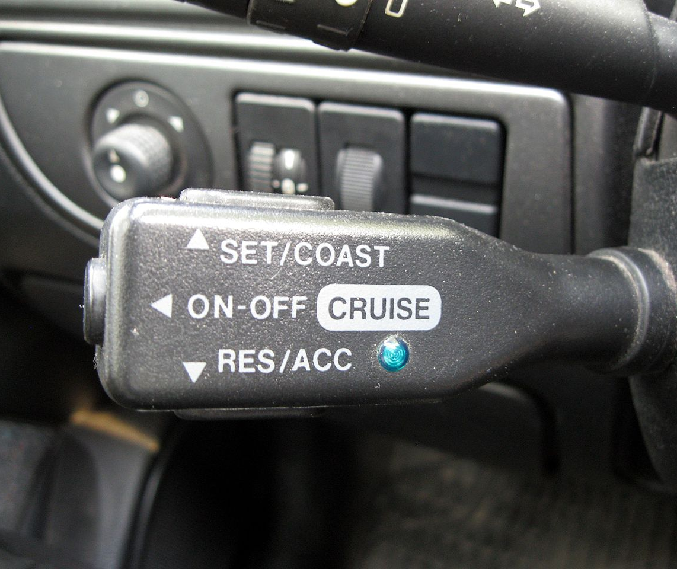
Goals
To control the mobile platform with a Motor Shield.
Use an ultrasonic sensor to alter the speed of the platform, like an adaptive cruise control system.

Slide 3
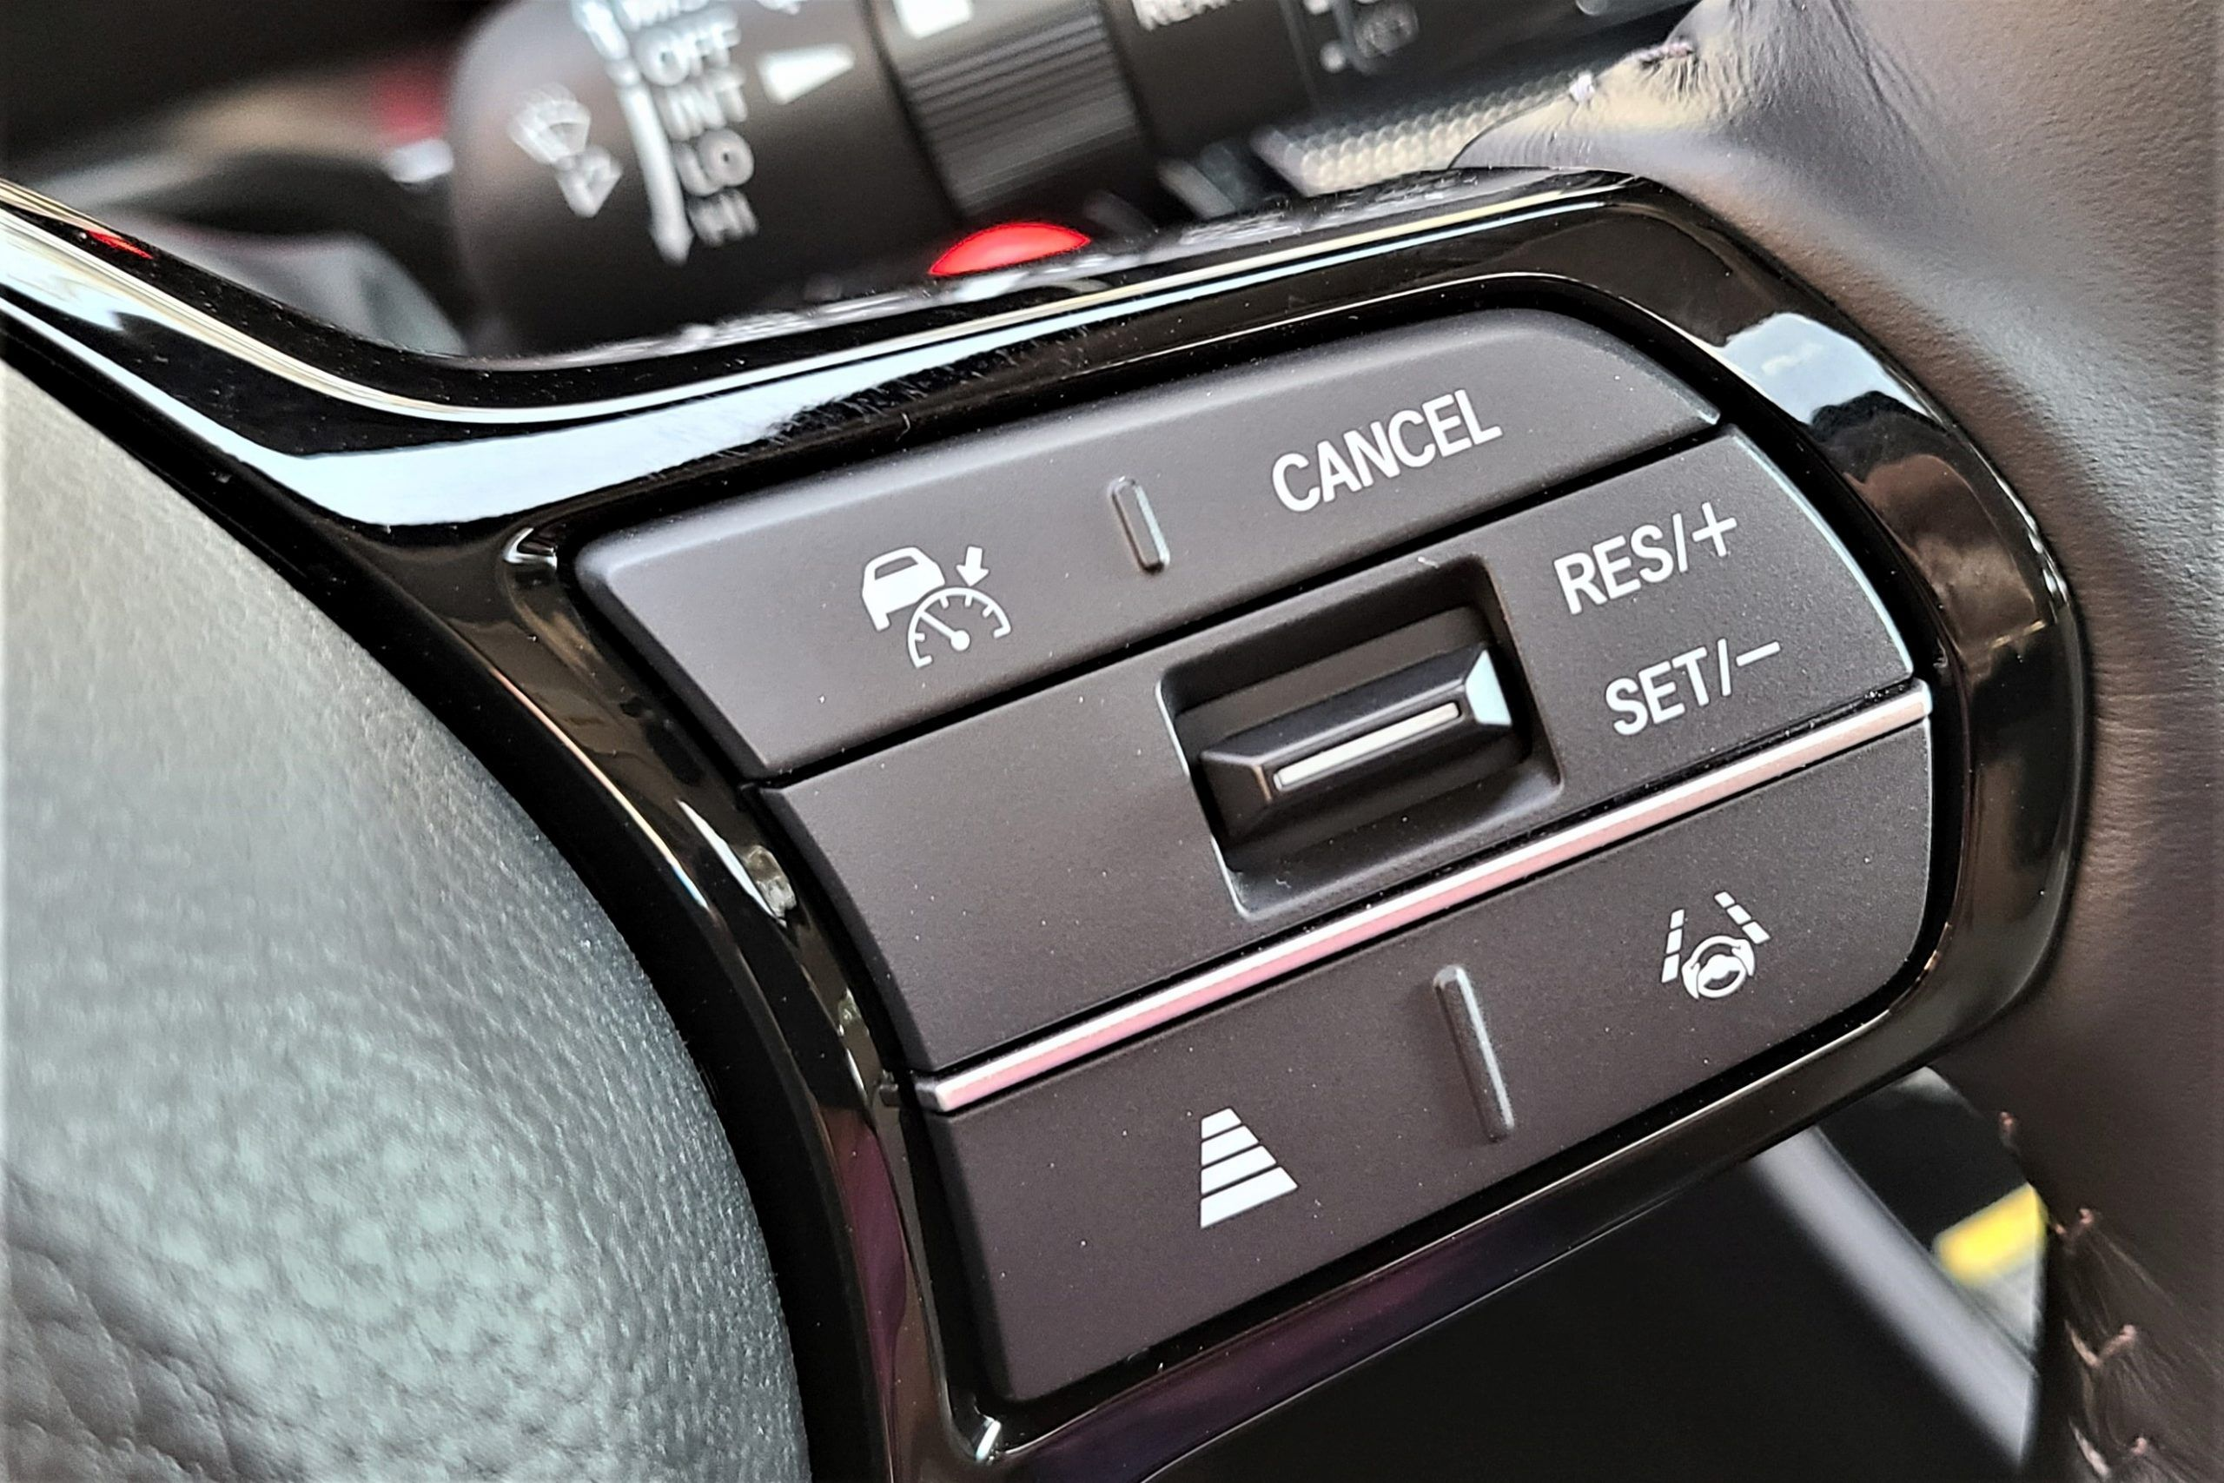
What is Cruise Control?
Cruise control maintains the vehicle at a certain speed no matter what its surroundings are
The driver is responsible for shutting off the cruise control or changing the speed it is set at
How can we make this cruise control safer and more convenient for drivers?

Slide 4
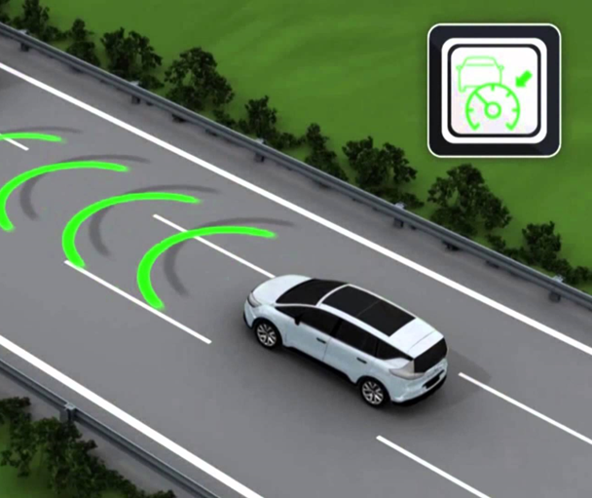
What is Adaptive Cruise Control?
Adaptive cruise control (ACC) is a system designed to help vehicles maintain a safe following distance and stay within the speed limit. This system adjusts a car's speed automatically.

Slide 5
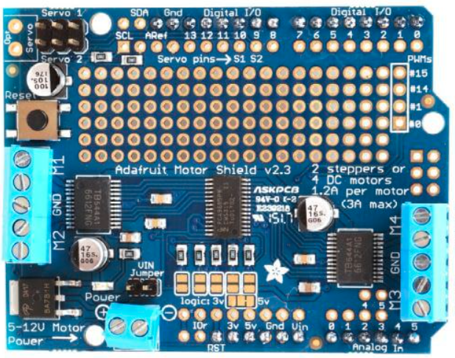
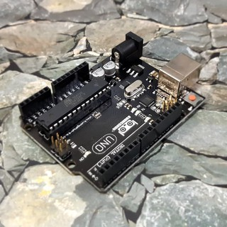
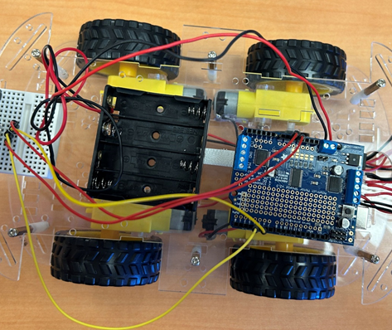
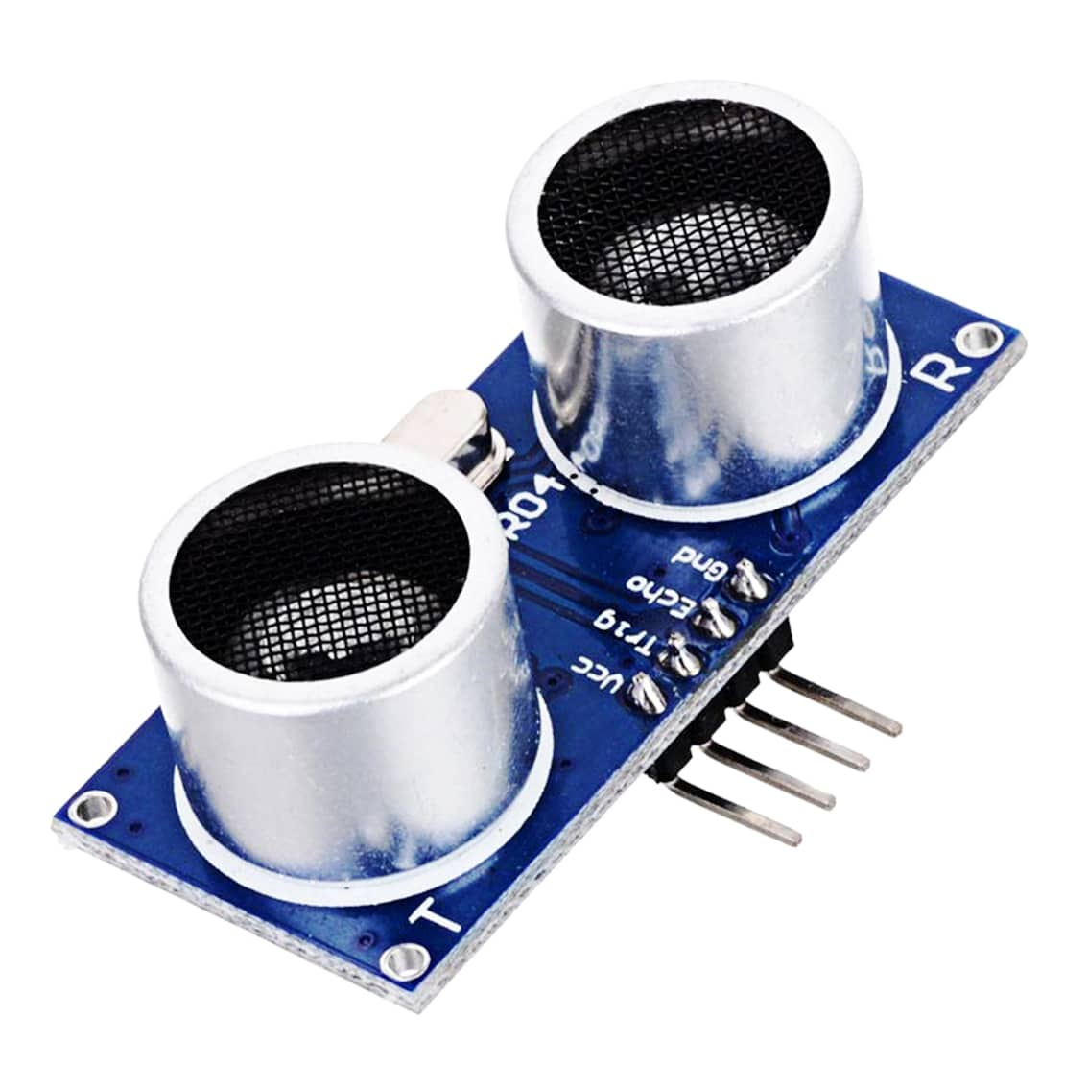
Materials
Mobile Platform
Motor Shield v2.3
Arduino
Ultrasonic Sensor
AA Battery Pack
Small Breadboard

Slide 6
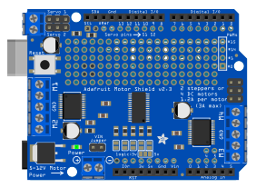
Adafruit Motor Shield
① DC power supply (AA battery pack)
② Power indicator LED
③ M1 motor connection ports
④ M2 motor connection ports
⑤ M3 motor connection ports
⑥ M4 motor connection ports
⑦ GND
⑧ Reset button
The Motor Shield allows us to control the direction and speed of the motors
⑧
③
⑥
⑦
⑦
④
⑤
②
①

Slide 7
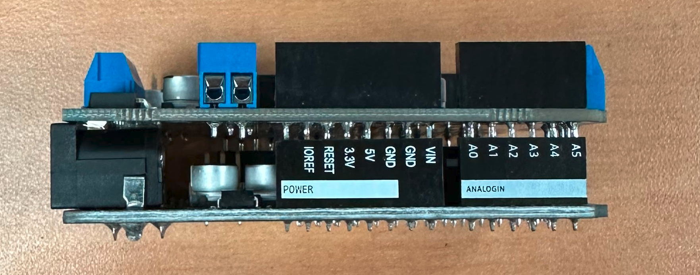
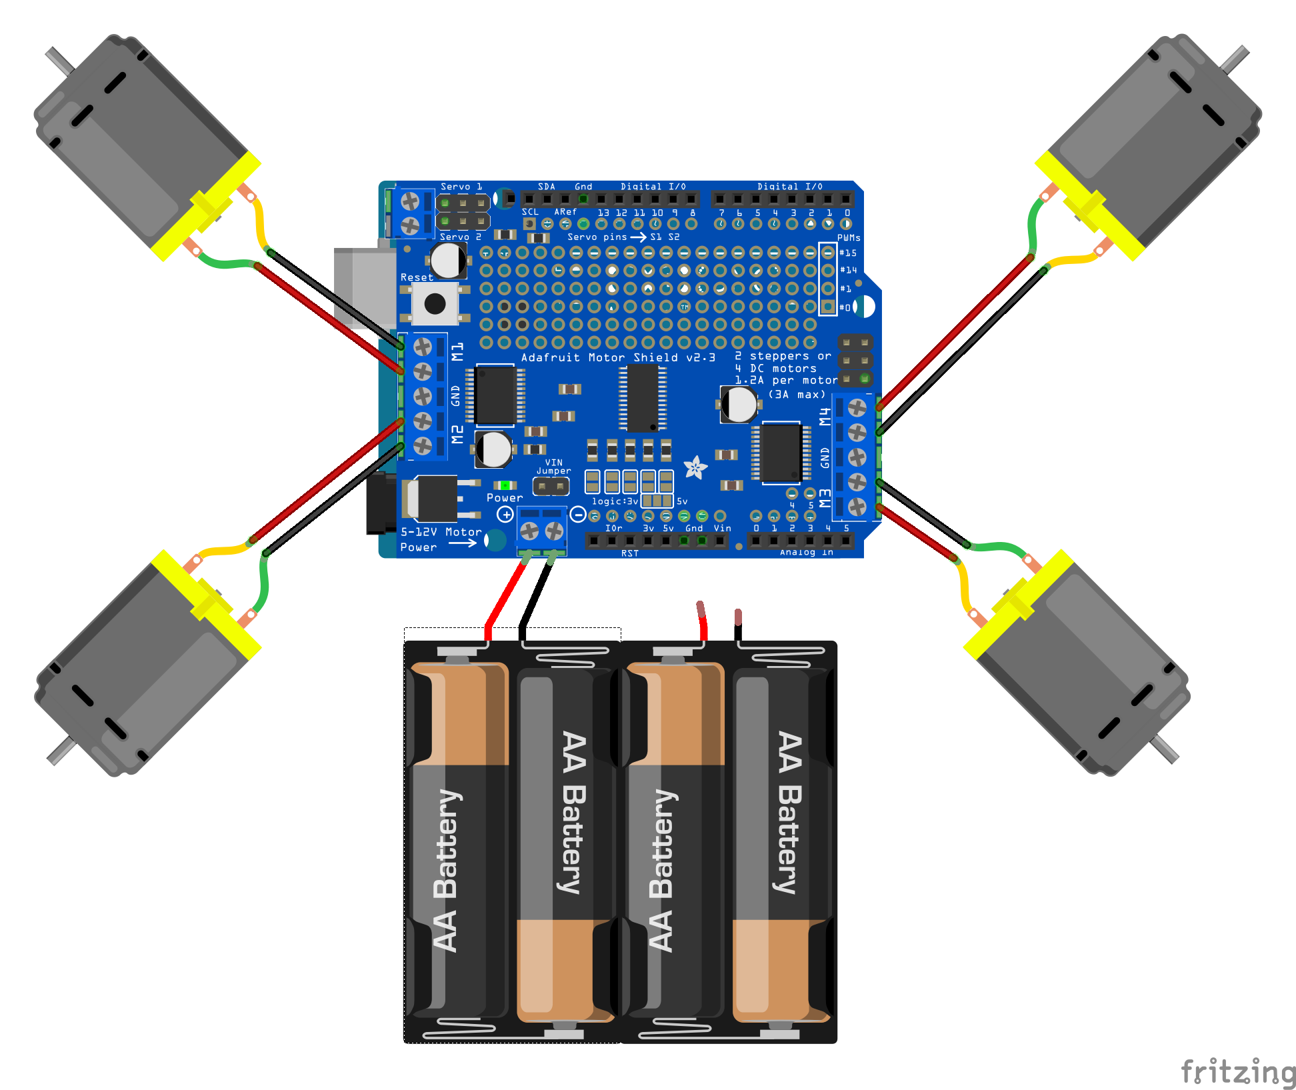
Installing the Motor Shield
Attach the motor shield to the Arduino board.
Try to avoid bending the pins.
You can now connect the motors and the battery to the shield.
The direction (plus vs. minus) of the DC motors does not matter at this point. If they spin the wrong direction, we will just adjust the code later to fix it.
Be sure the battery pack is connected in the correct directions. Red to positive; black to negative.
Do not put all four batteries in the battery pack until you have double checked your circuit.
M4 Rear Right Motor
M1 = Front Left Motor
M2 = Front Right Motor
M3 Rear Left Motor

Slide 8
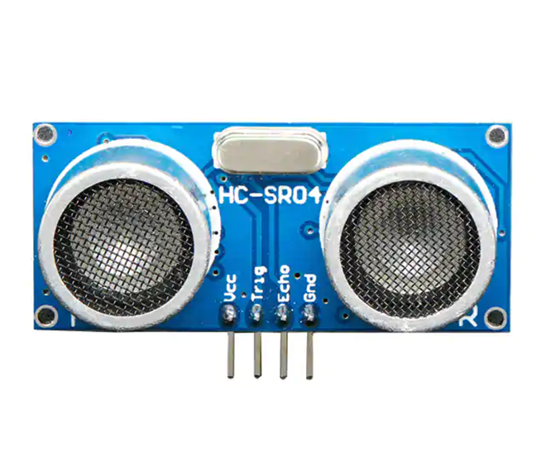
Ultrasonic Sensor (HC-SR04)
Ultrasonic sensors are distance sensors capable of capturing Ultrasound reflections.
Ultrasound waves (~40kHz) are the high frequency sounds above the audible range for human ears (20 Hz – 20 kHz).
Two pins (Vcc and Gnd) are used for supply (Positive and Negative).
The other two pins (Trig and Echo) are used to send and receive the ultrasonic pulse.

Slide 9
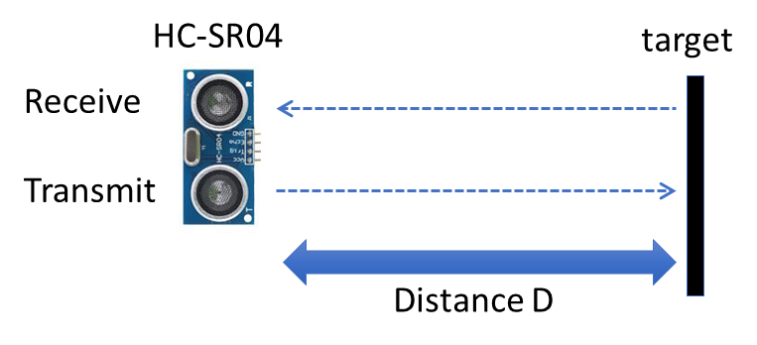
Sound Velocity and Distance
The total distance traveled by the ultrasonic wave is twice the distance to the object
Measures the time the wave takes to travel

Slide 10
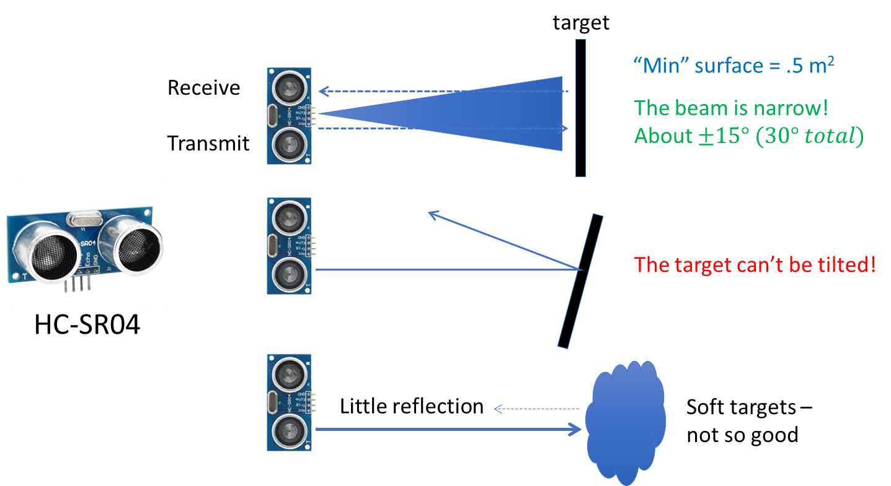
Possible Issues

Slide 11
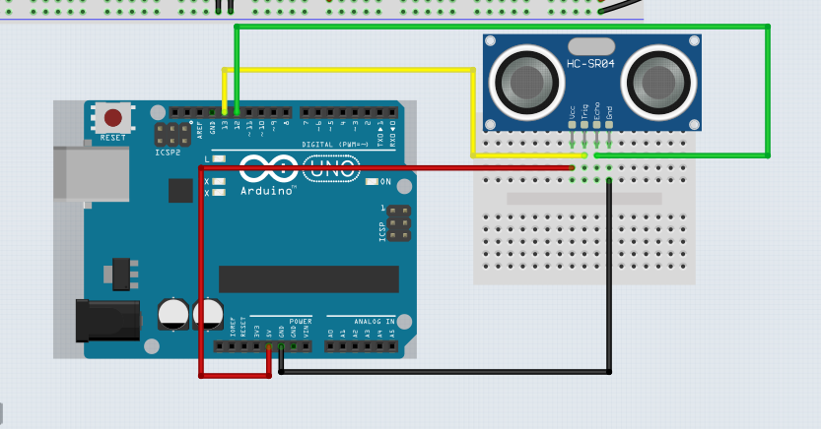
Ultrasonic Wiring
GND → Ground
VCC → +5V
Trig → 13
Echo → 12

Slide 12
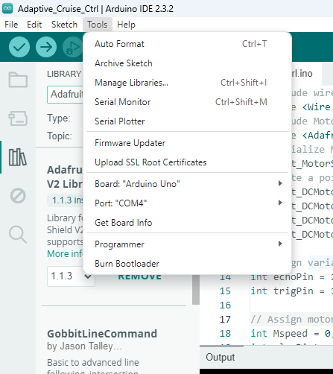
Installing Libraries
We need to install a library to use the motor shield
Click on ‘Tools’ at the top left
Locate ‘Manage Libraries’ and click on it
Search for ‘Adafruit Motor Shield V2 Library’ and install this library

Slide 13
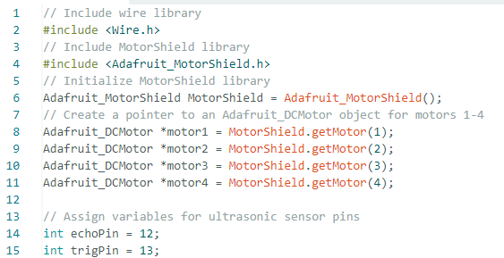
Completing the Code

Slide 14
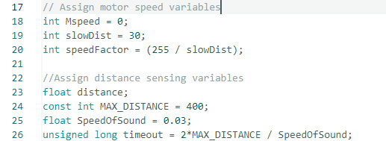
Completing the Code

Slide 15
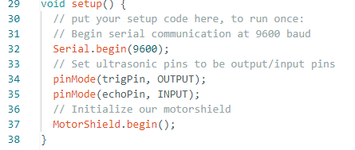
Completing the Code

Slide 16
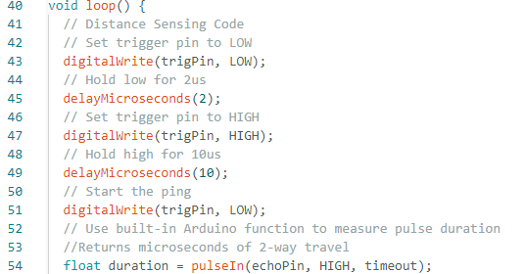
Completing the Code

Slide 17
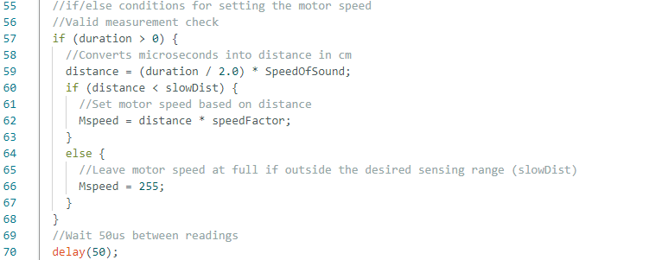
Completing the Code

Slide 18
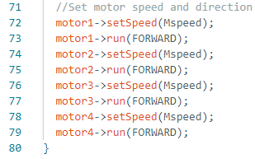
Completing the Code
This code is already filled in for you
Note: If you need to reverse the direction of any motor change “FORWARD” to “BACKWARD”

